Slide 1
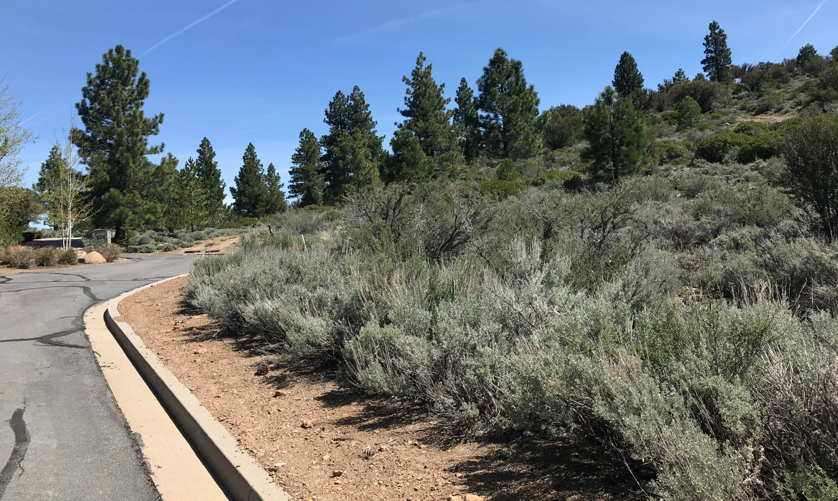
WSUP19-0008 Houston Grading
Washoe County Board of Adjustment
June 6, 2019

Slide 2
Request
The application is requesting a special use permit (SUP) for major grading of an area of approximately 35,400 sq. ft. with 7,428 cubic yards of cuts and 2,769 cubic yards of fill; to allow slopes greater than 10 feet in height; and to allow for the use of gabions.

Slide 3
Request
The SUP regulations allow “varying standards of the Development Code” as part of the approval of a special use permit “per WCC Section 110.810.20(e)
The applicant is requesting to vary the standards to allow slopes greater than 10 feet in height and to allow the use of gabions

Slide 4
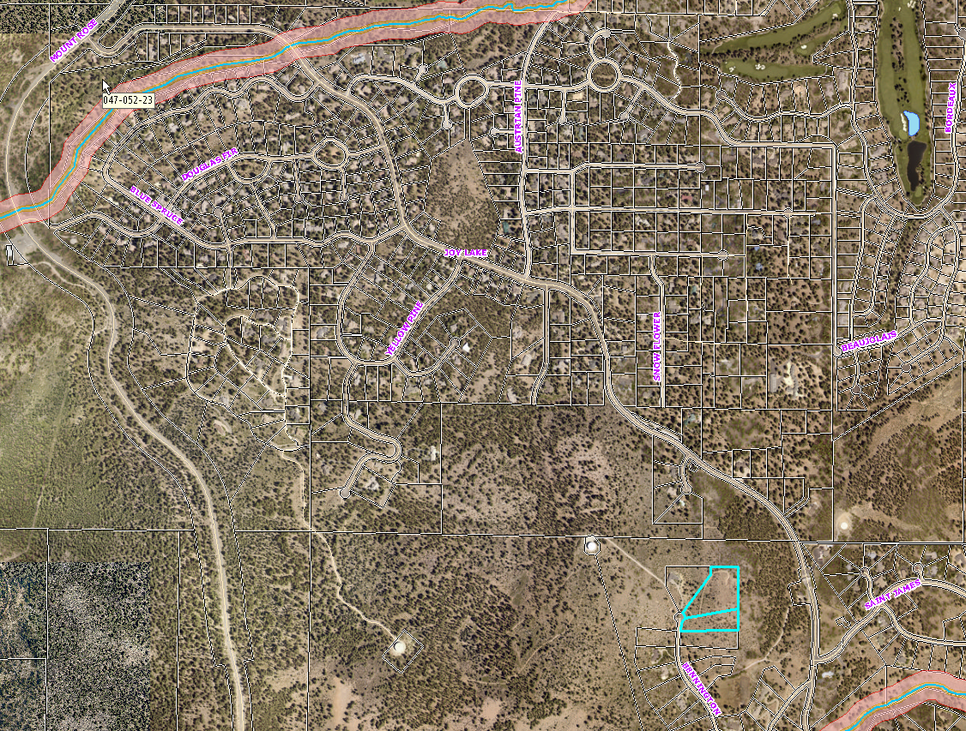

Slide 5
Background
The two parcels are in the St. James Village development, which has a Homeowners Association (HOA)
The site is undeveloped with trees and native vegetation
The applicant will landscape and reseed the area disturbed with vegetation that is approved by the St. James Village HOA and temporary irrigation will be installed

Slide 6
Background
The request is to grade two parcels to construct a driveway for a single family residence
There is a dirt driveway on one of the parcels, however, it was determined to be too steep to meet the fire district requirements
The property owners acquired the second parcel to construct the driveway and the driveway will cross both parcels

Slide 7
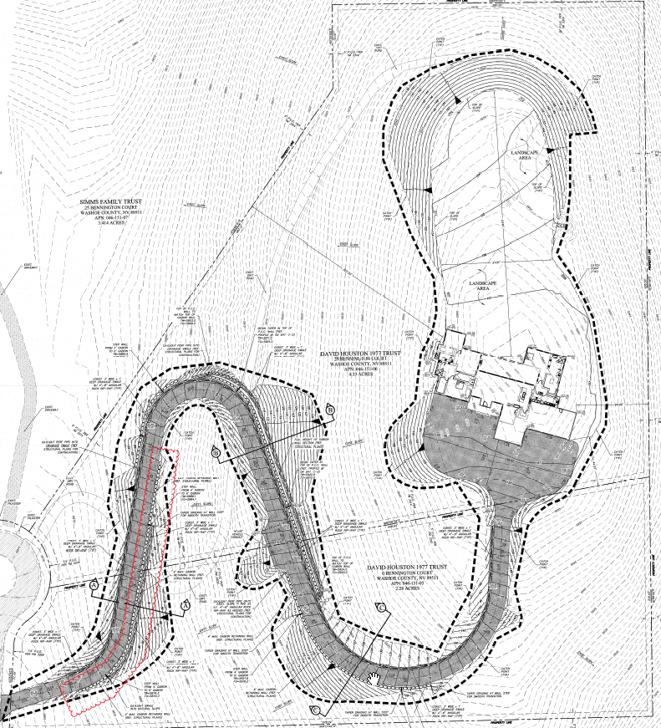

Slide 8
Analysis
Grading will occur to construct the driveway and for some areas around the proposed house
There are locations along the driveway where the natural slopes will be varied by more than 10 feet in elevation, by approximately two feet more than the WCC allows
The applicant is requesting to vary this requirement

Slide 9
Analysis
The applicant is also requesting to use gabion cages in front of the retaining walls so only 6 feet of the concrete walls will be visible
This will meet St. James Village requirement “of no more than 6 feet of retaining walls can be visible”

Slide 10
Public Notice & CAB
Public notice was sent to parcel within 500 feet from the site
The South Truckee Meadows/Washoe Valley CAB reviewed the application on May 2, 2019 and recommended to approve the project.

Slide 11
Reviewing Agencies
Various agencies reviewed the application, their comments are included in the staff report
Agencies with conditions, are included in the Conditions of Approval

Slide 12
Special Us Permit Findings
1. Consistency;
2. Improvements;
3. Site Suitability; and
4. Issuance Not Detrimental
Staff is able to make all the required findings, as detailed in the staff report on Page 7

Slide 13
Possible Motion
I move that, after giving reasoned consideration to the information contained in the staff report and information received during the public hearing, the Washoe County Board of Adjustment approve with conditions Special Use Permit Case Number WSUP19-0008 for David Houston, having made all four findings in accordance with Washoe County Code Section 110.810.30

